Slide 1
MAJOR PROJECT YOGA POSE DETECTION REVIEW II
DONE BY GUIDED BY
SARANYA M Dr Rajdeepa B
21BIT036 ( III BSc IT )
MCA MPhil MSC(YHE) PhD
Associate Professor,
Head Of the Department,
Department of Information Technology

Slide 2
ABSTRACT:
This project focuses on the detection of Yoga Pose system using Python. The system aims to accurately identify and analyze yoga poses from webcam by using various kind of libraries which is used to analyze and find out the yoga poses. The process involves collecting a diverse dataset of yoga poses. This dataset should include videos of individuals performing various yoga poses, with each pose labeled for training purposes.
A machine learning model, trained on a diverse dataset of yoga poses, is employed to classify and track the user's current pose. The system is designed to be user-friendly, requiring minimal setup and no specialized equipment. We use Pose estimation libraries like Tensorflow, keras and mediapipe to extract the key points or joints of a person on a screen. These libraries help in understanding the body’s pose and positioning.

Slide 3
Python is chosen as the programming language for its versatility and extensive libraries in the field of machine learning. Libraries such as TensorFlow, OpenCV and mediapipe can aid in image processing and pose estimation. The proposed system not only aids practitioners in maintaining proper alignment but also offers a personalized and interactive experience. By leveraging technology to monitor and correct yoga poses, individuals can enhance their home practice, reduce the risk of injury, and deepen their understanding of yoga postures.

Slide 4
EXISTING SYSTEM
The systems often required a pre-recorded video or a series of images for offline analysis. While they provided valuable insights into pose accuracy, they might lack real-time feedback and user interaction.

Slide 5
EXISTING SYSTEM DISADVANTAGES
Some systems may be optimized for a specific set of yoga poses, and they might not perform well when confronted with a wide variety of poses. This limitation can impact the system's applicability to diverse yoga practices.
Occlusions, where parts of the body are temporarily hidden from the camera's view, can pose challenges for accurate pose detection. The system may fail to accurately estimate poses when certain body parts are obscured.
Existing systems may struggle to accurately detect poses during dynamic and fast movements, common in certain styles of yoga. Rapid changes in body positions can lead to pose misclassification or delays in detection.

Slide 6
PROPOSED SYSTEM
The primary purpose of this project is to assist individuals in enhancing their home yoga practice, helping them to maintain proper form and alignment without the need for a physical instructor.
The project can serve as an educational tool for individuals learning yoga.

Slide 7
PROPOSED SYSTEM ADVANTAGES
Utilize a standard webcam as the input device for capturing the user's live video feed
Incorporate dynamic pose templates that adapt to variations in individual body shapes and sizes. This ensures a personalized experience, accommodating different levels of flexibility and expertise.
Provide educational resources within the system, such as links to instructional videos, pose descriptions, and tips for improving yoga practice. This enhances the educational aspect of the system.
Provides a natural interaction between humans and computers without the use of any extra devices, thereby reducing costs.

Slide 8
SYSTEM SPECIFICATION
HARDWARE CONFIGURATION:
System: DTJA08M
Processor: Intel(R) Core(TM) i5-7200U CPU @ 2.50GHz 2.70 GHz
Ram: 4.00GB
Web cam
SOFTWARE SPECIFICATION:
Operating System: Windows 8 and Above
IDE: VisualStudio Code
Programming Language: Python 3.8.10
Python libraries: OpenCV, NumPy, Keras,mediapipe,Tensorflow

Slide 9
MODULE DESCRIPTION
Data Acquisition:
The different approaches to acquire data about the body gesture can be done in the following ways:
It uses electromechanical devices to provide exact body configuration, and position. Different position-based approaches can be used to extract information. But it is expensive and not user friendly.
In vision-based methods, the computer webcam is the input device for observing the information of body poses.
The Vision Based methods require only a camera, thus realizing a natural interaction between humans and computers without the use of any extra devices, thereby reducing costs.
The main challenge of vision-based yoga pose detection ranges from coping with the large variability of the yoga pose appearance due to a huge number of body movements, to different skin-color possibilities as well as to the variations in viewpoints, scales, and speed of the camera capturing the scene.

Slide 10
Data pre-processing and Feature extraction:
In this approach for yoga pose detection, initially we detect body pose from image that is acquired by webcam and for detecting a yoga pose, we used media pipe library which is used for image processing.
So, after finding the yoga pose from image we get the region of interest (Roi) then we cropped that image and convert the image to gray image using OpenCV library after we applied the gaussian blur .
The filter can be easily applied using open computer vision library also known as OpenCV.
Then we converted the gray image to binary image using threshold and Adaptive threshold methods.

Slide 11
Gesture Classification :
Convolutional Neural Network (CNN)
CNN is a class of neural networks that are highly useful in solving computer vision problems.
They make use of a filter/kernel to scan through the entire pixel values of the image and make computations by setting appropriate weights to enable detection of a specific feature. CNN is equipped with layers like convolution layer, max pooling layer, flatten layer, dense layer, dropout layer and a fully connected neural network layer.
These layers together make a very powerful tool that can identify features in an image. The starting layers detect low level features that gradually begin to detect more complex higher-level features
Unlike regular Neural Networks, in the layers of CNN, the neurons are arranged in 3 dimensions: width, height, depth.
Moreover, the final output layer would have dimensions(number of classes), because by the end of the CNN architecture we will reduce the full image into a single vector of class scores.

Slide 12
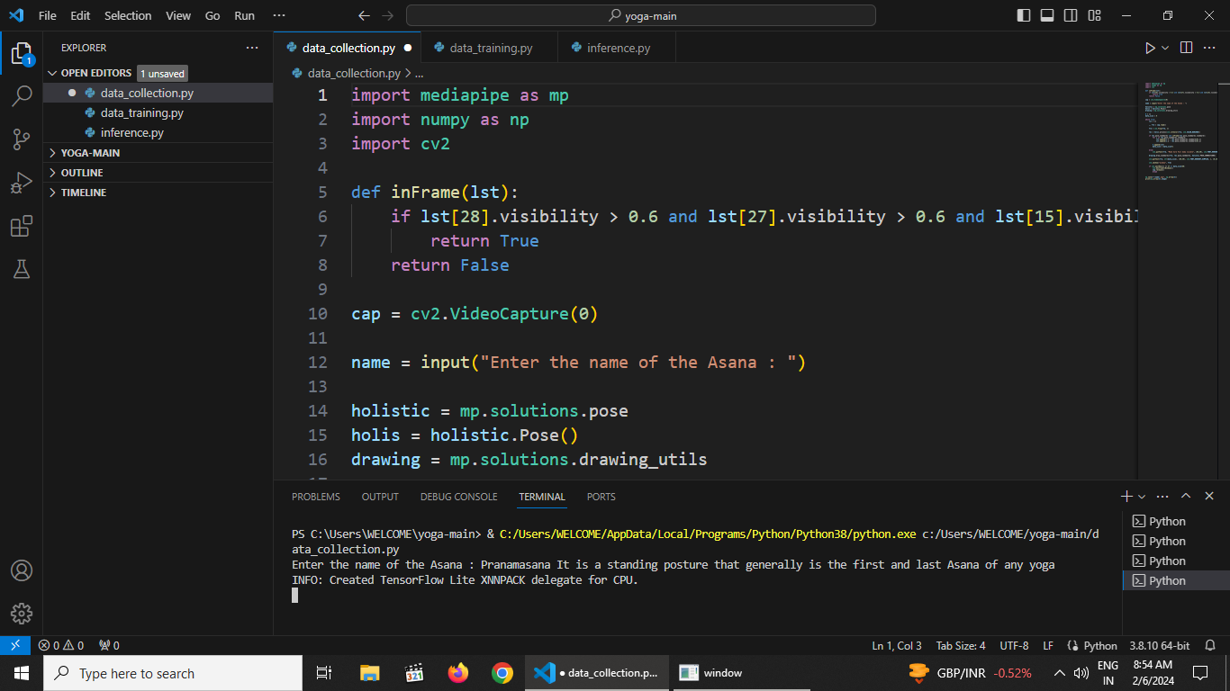
INPUT:

Slide 13
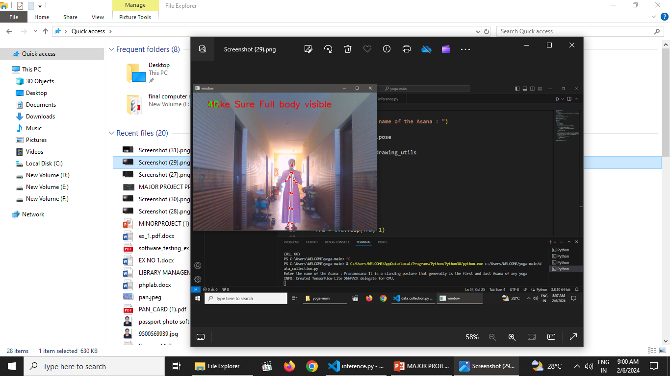

Slide 14
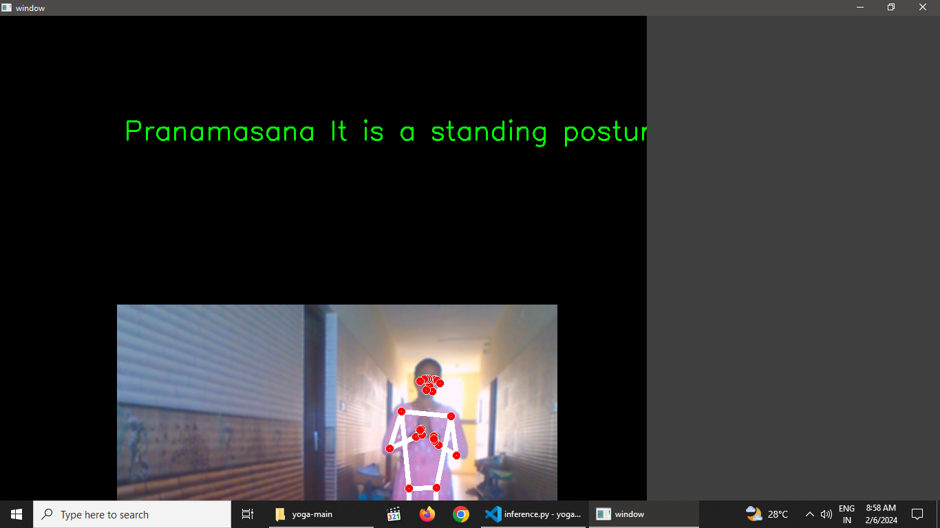
OUTPUT:

Slide 15
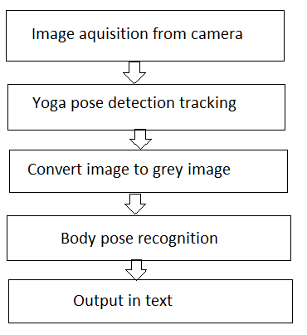
Block diagram

Slide 16
CONCLUSION:
The project is a simple demonstration of how CNN can be used to solve computer vision problems with an extremely high degree of accuracy.
The yoga pose detection is obtained which has an accuracy of 95%.
The project can be extended to other body poses by building the corresponding dataset and training the CNN. The main objective has been achieved, that is, the need for an interpreter has been eliminated.
If this issue is encountered, we need to either reset the histogram or look for places with suitable lighting conditions.
The other issue that people might face is regarding their proficiency in knowing the ASL gestures. Bad gesture postures will not yield correct prediction.

Slide 17
References:
https://github.com/Pawandeep-prog/yoga
Youtube- https://www.youtube.com/watch?v=sIRqrwZnuHE

Slide 18
THANK YOU..!!

